Slide 1

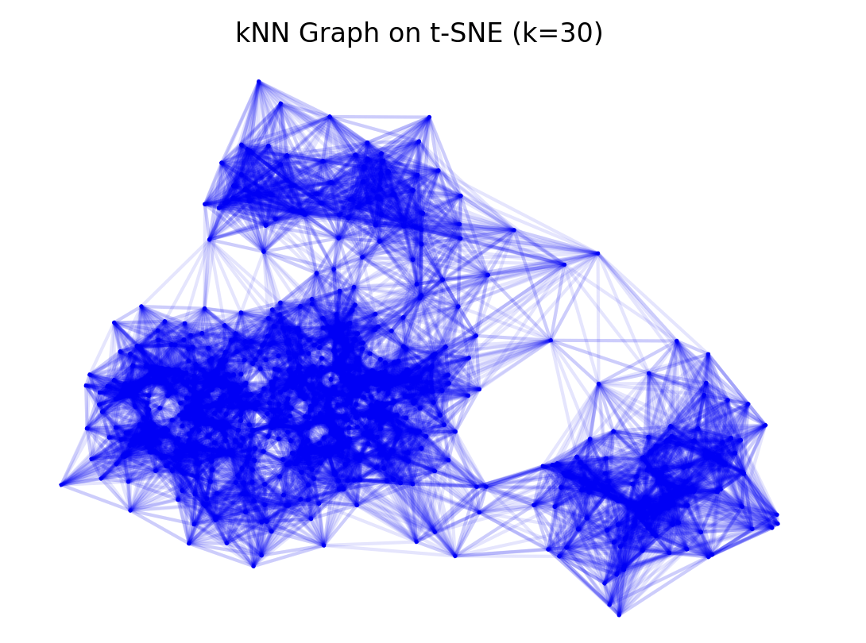
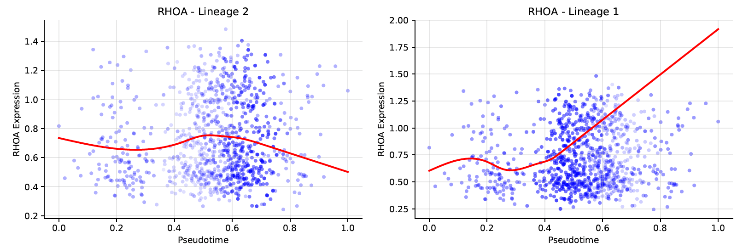
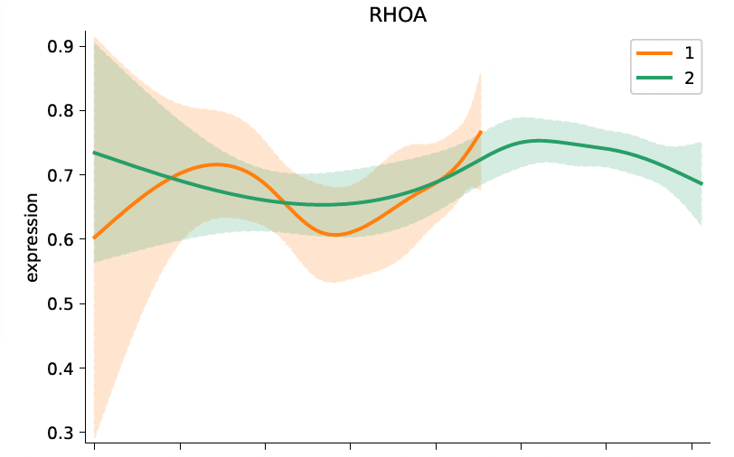
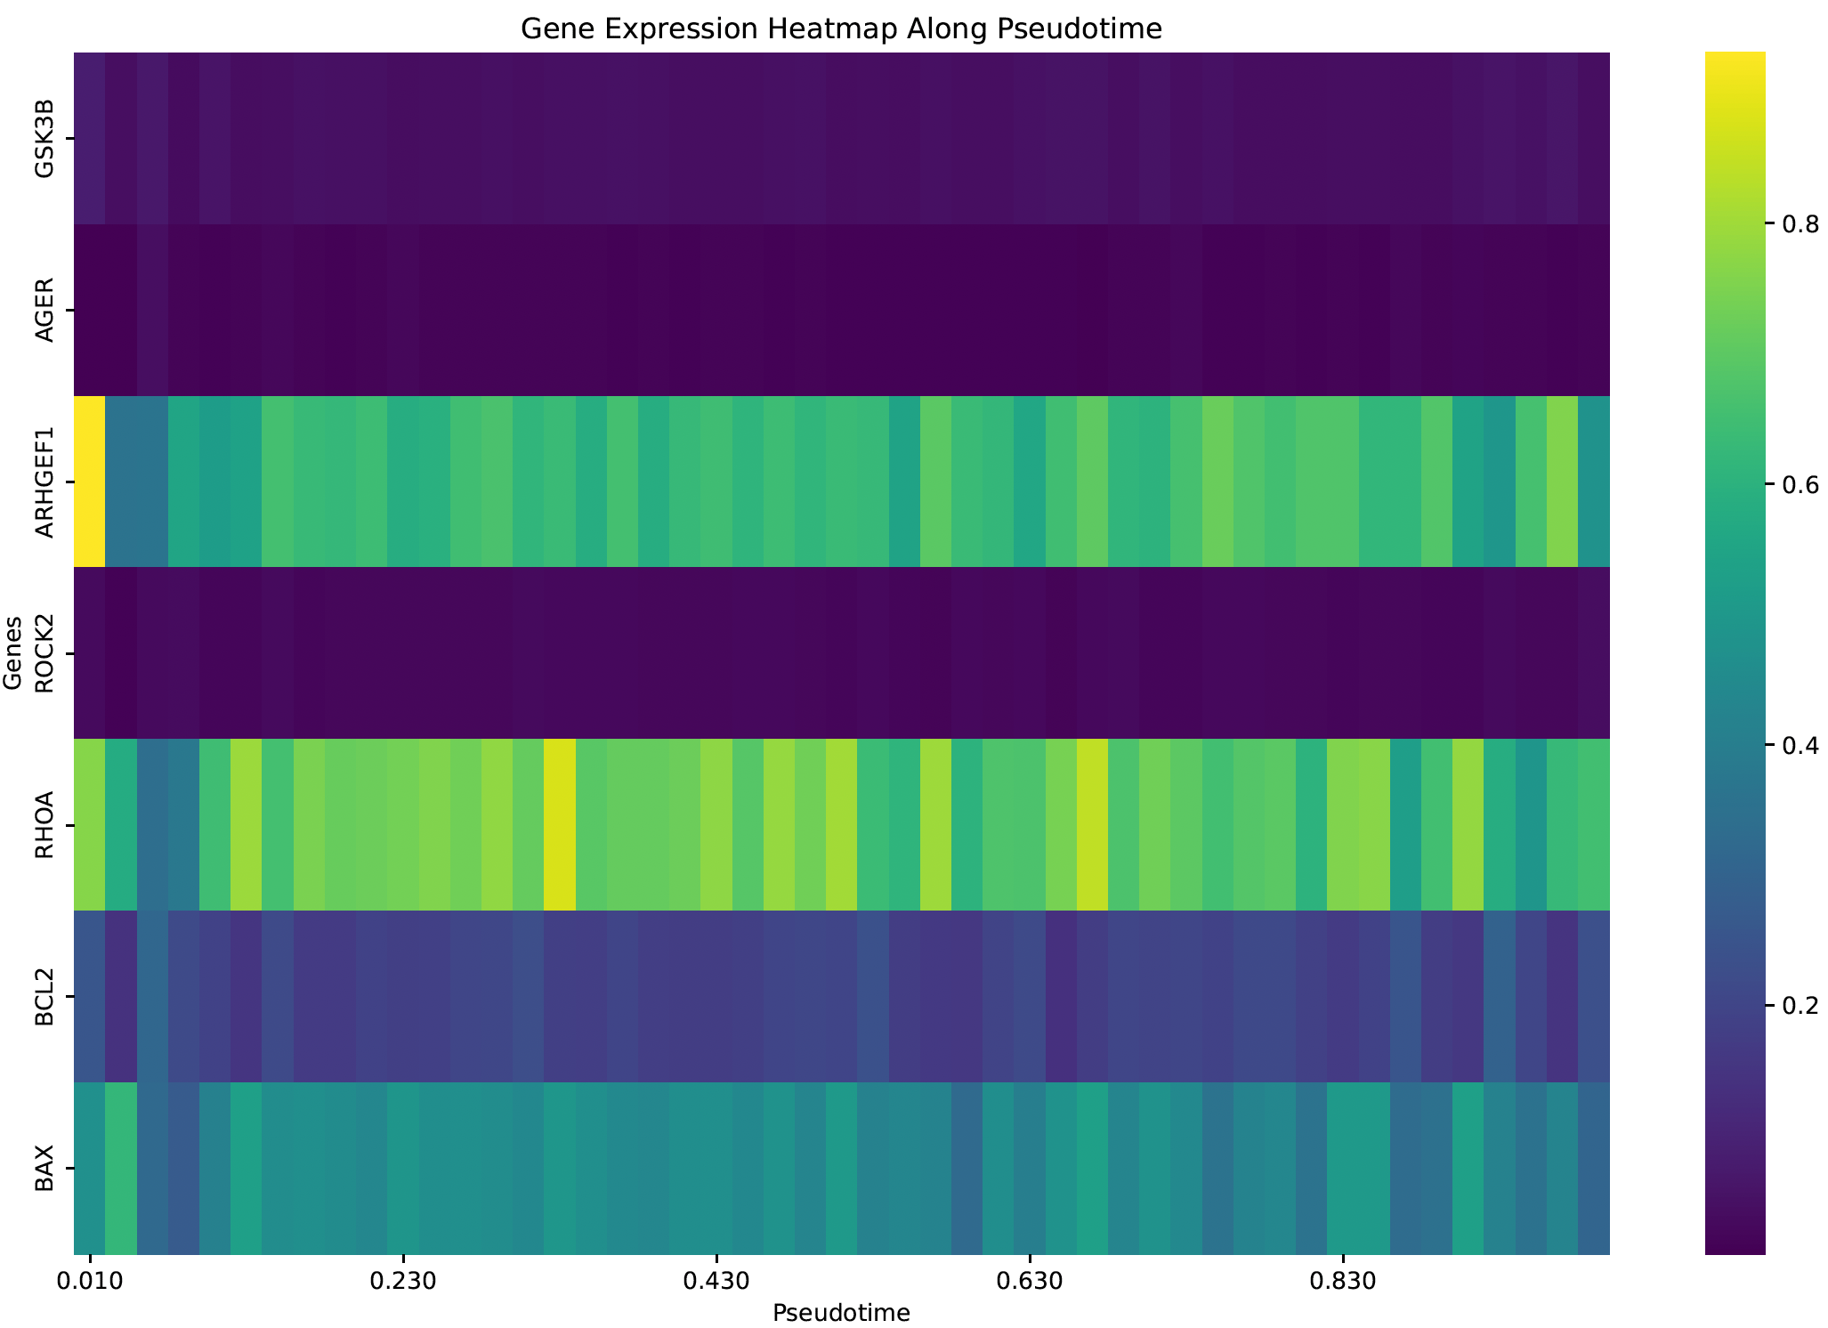
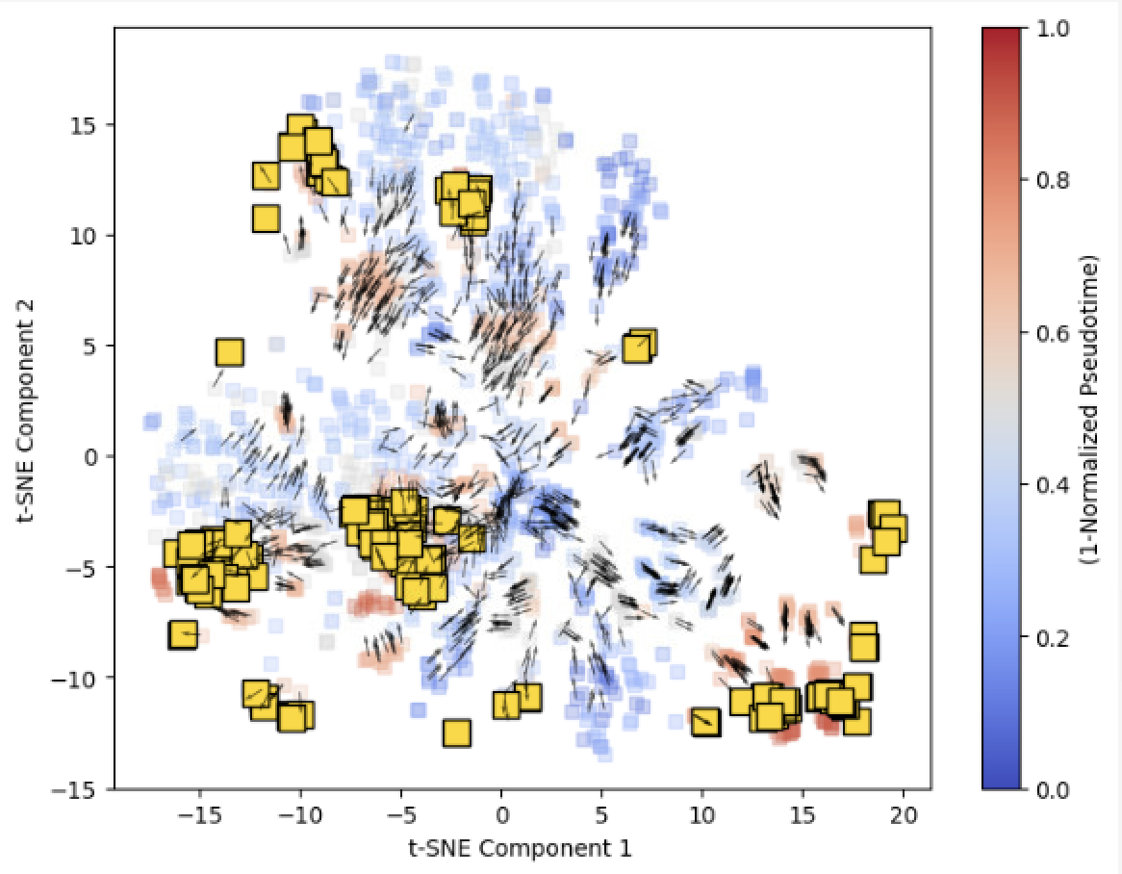
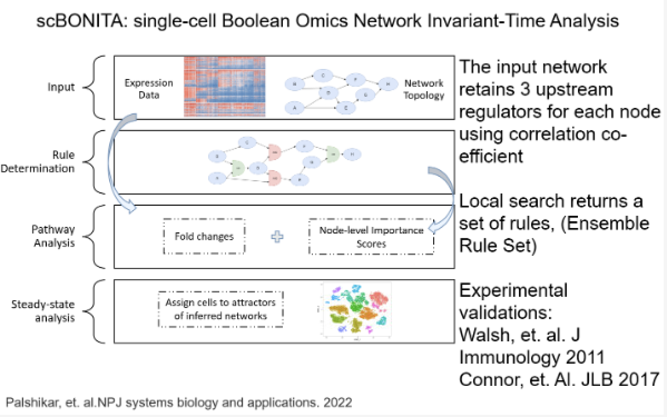
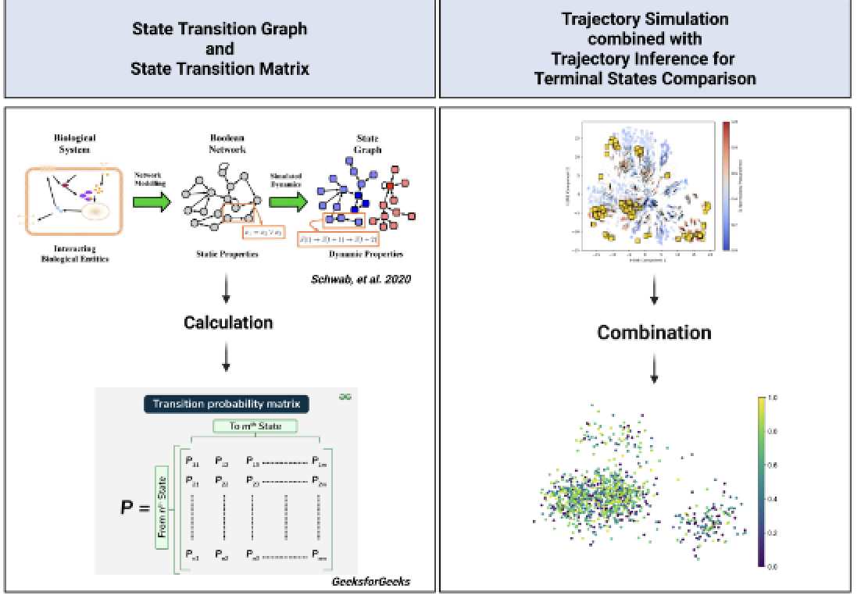
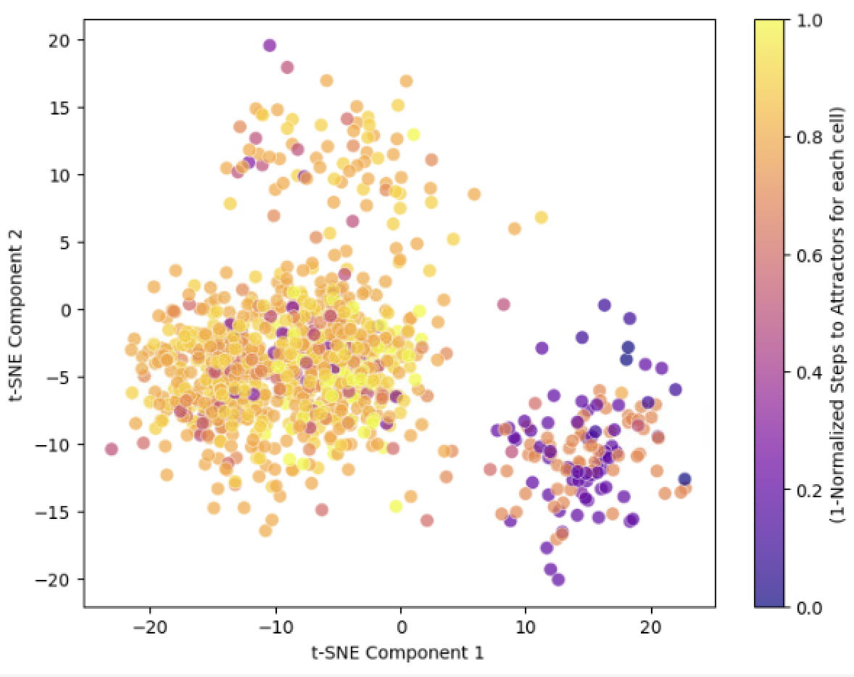
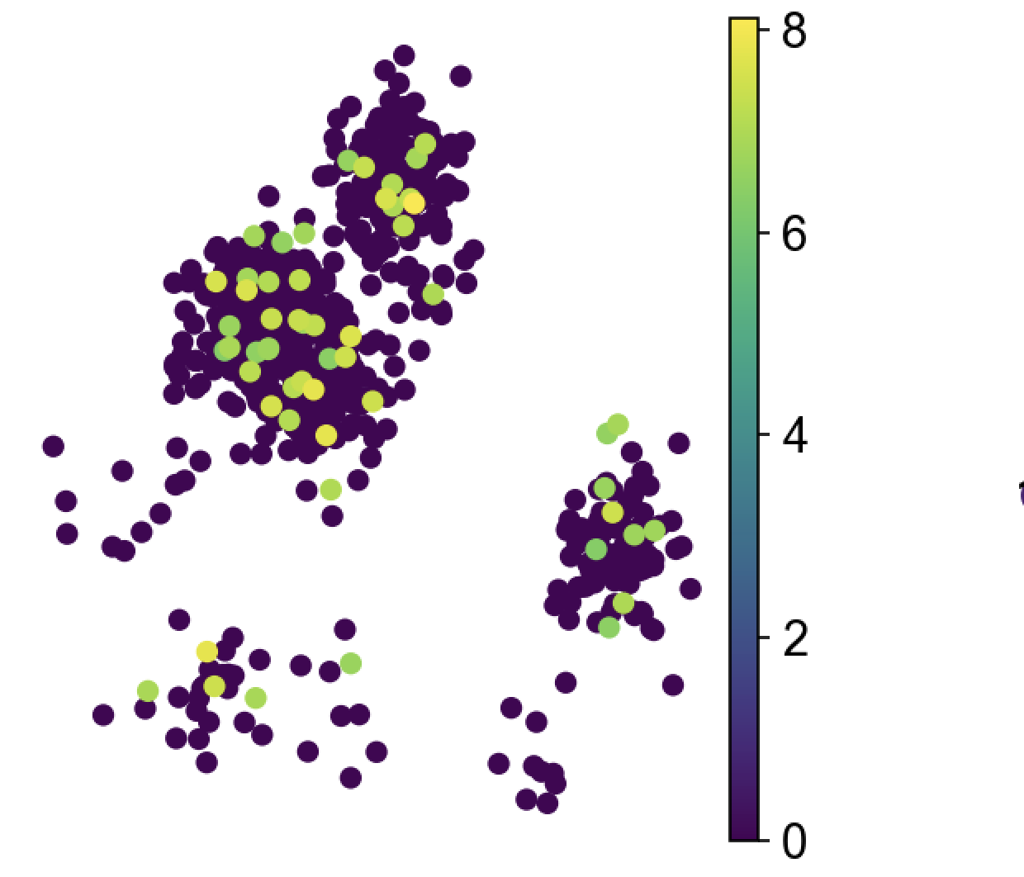
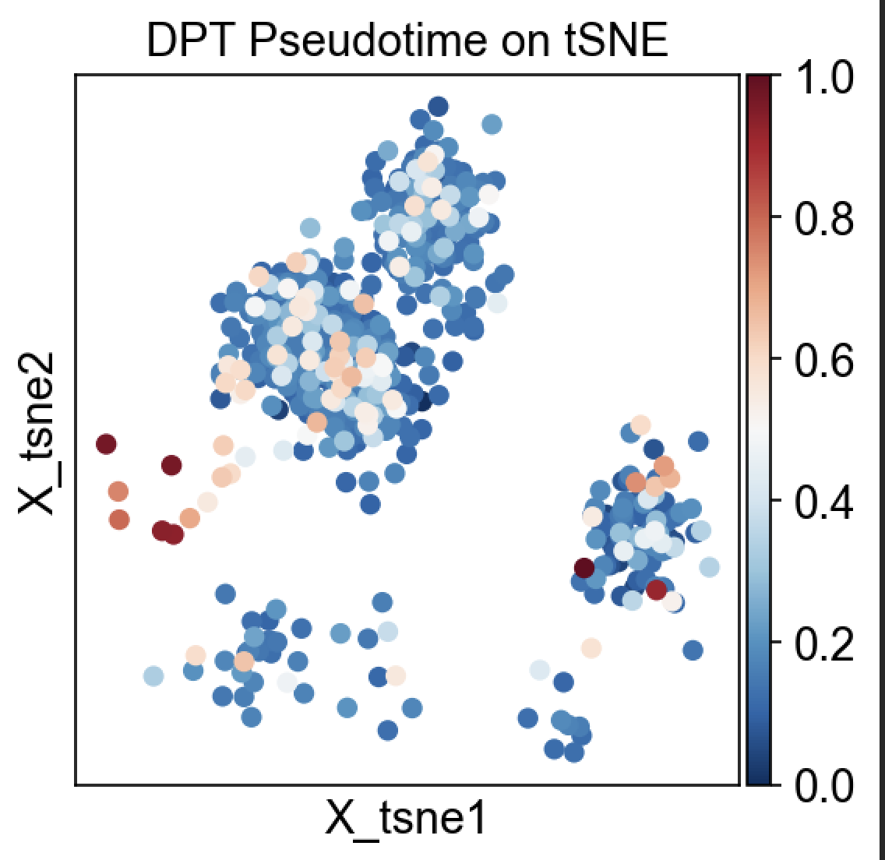
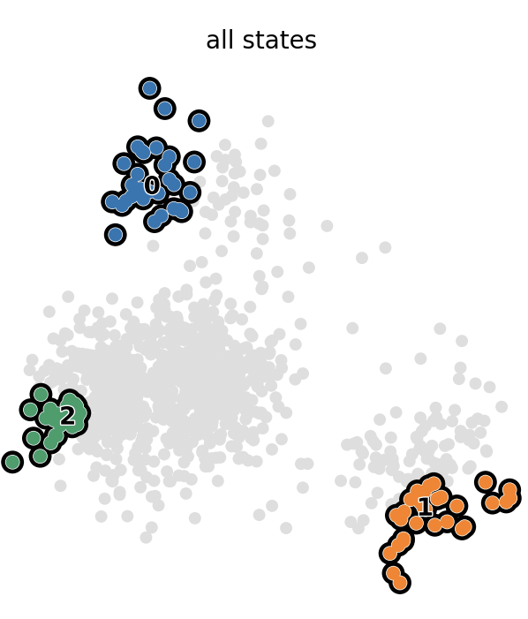
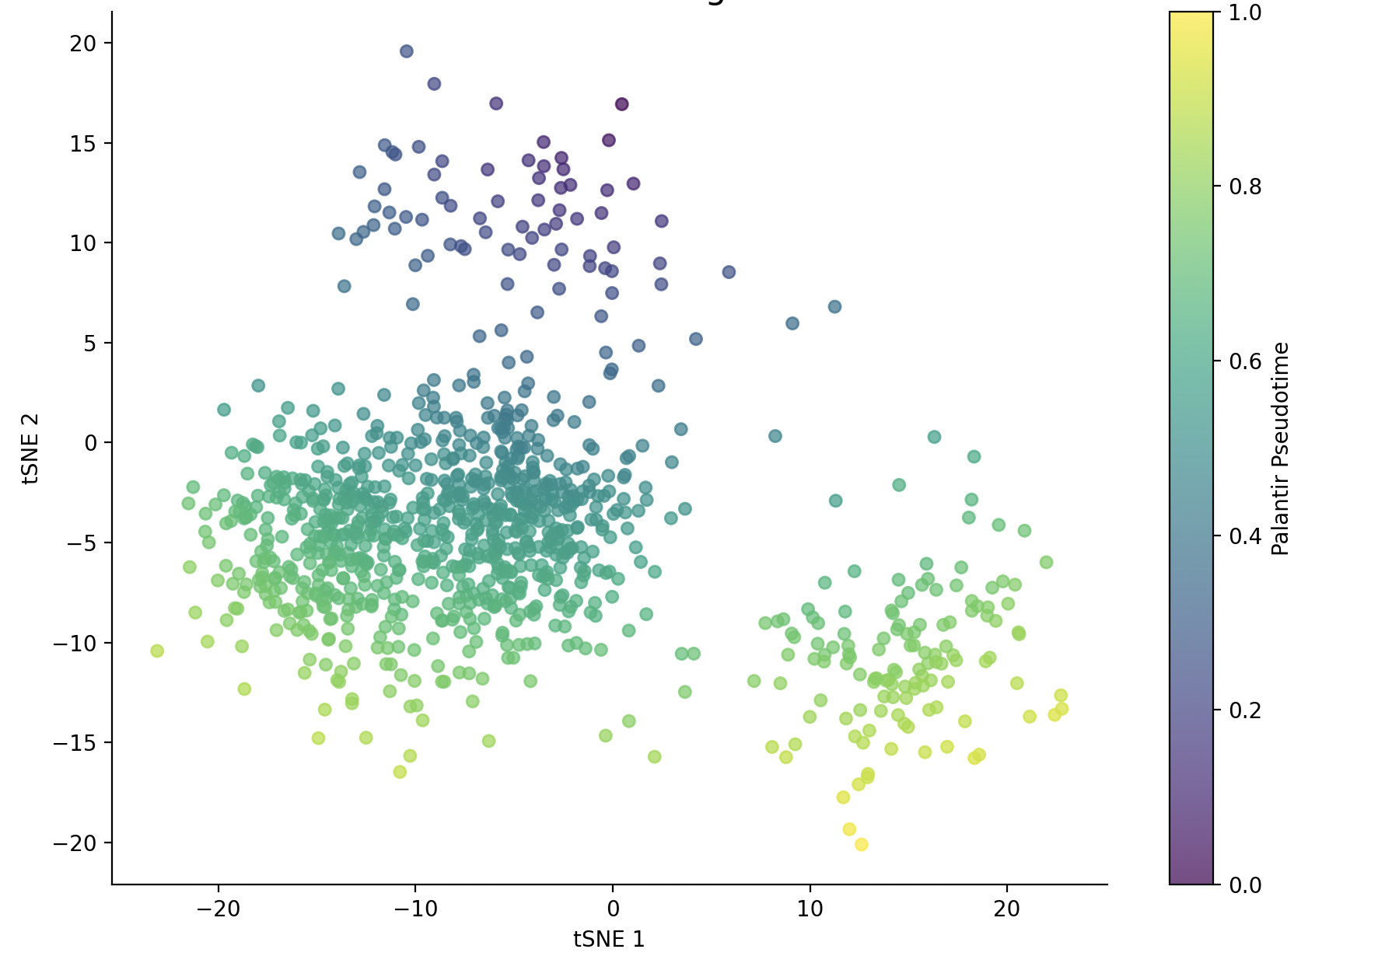
Merging Dynamic State Models with Single-Cell Pseudotime Trajectories and Cell Fates in HIV-Associated Atherosclerosis
Nhung Nguyen¹, Pancy Lwin PhD², Juilee Thakar PhD^{2,3,4}
¹The College of Wooster, ²URMC Department of Microbiology and Immunology, ³URMC Department of Biostatistics & Computational Biology, ⁴URMC Department of Biomedical Genetics
Introduction
ScBONITA2.0: Boolean attractor landscape
CellRank2.0: Plotting Gene Expression Across Lineages
Boolean network models provide a framework to simulate intracellular signaling dynamics by modeling state transitions within gene regulatory networks.
scBONITA (single-cell Boolean Omics Network Invariant-Time Analysis) uses single-cell RNA-seq data to generate executable Boolean models of dysregulated signaling pathways.
Previous applications of scBONITA in HIV-associated atherosclerosis (AS) revealed immune signaling alterations in CD8⁺ T cells and monocytes, helping uncover cell-type–specific disease mechanisms.
scBONITA2.0 expands this approach by integrating trajectory inference and pseudotime analysis, enabling dynamic tracking of signaling state transitions over the course of disease progression.
Methods: We applied scBONITA2.0 to single-cell RNA-seq data from peripheral blood mononuclear cells (PBMCs) of individuals living with HIV. Cells were embedded in a two-dimensional t-SNE space to visualize transcriptomic structure, and a k-nearest neighbor (kNN) graph (k=30) was constructed to capture transcriptional similarity. Boolean attractor states were inferred to model stable cellular signaling behaviors, and each cell’s distance to its nearest attractor was computed using model-based dynamic transitions through the state space.
Results: Top: Cells are colored by pseudotime to show progression through dynamic states, with arrows indicating the predicted direction of transitions. Yellow boxes represent inferred attractor states that mark stable signaling behaviors. Middle: The kNN graph visualizes transcriptional similarity among cells, forming distinct clusters that may reflect functional or phenotypic states. Bottom: Cells are colored by the number of inferred steps required to reach their nearest attractor. Cells with lighter colors are closer to their attractor, suggesting convergence toward stable regulatory states and lower signaling entropy.
scBONITA and scBONITA2.0
scBONITA: Computational pipeline that builds executable Boolean models of cell signaling pathways using single-cell RNA-seq data
scBONITA 2.0: enhances the original framework with improved scalability, support for multi-sample integration, and greater model accuracy
Method: We analyzed gene expression dynamics along inferred lineages using CellRank2.0 and the GAMR model.
Results: Top: Smoothed expression of RHOA is shown across two terminal lineages (Lineage 1 and Lineage 2) as a function of Palantir pseudotime, revealing lineage-specific upregulation in Lineage 1. Bottom Left: Generalized Additive Model Regression (GAMR) visualization shows the smoothed expression of RHOA with 95% confidence intervals, highlighting divergent trajectories between lineages. Bottom Right: Heatmap of selected genes illustrates expression changes over pseudotime, identifying genes like RHOA, BCL2, and AGER with dynamic, lineage-dependent expression patterns.
Trajectory Inference with PAGA and DPT
CellRank2.0 + Palantir: Terminal State Prediction
Future Directions
References
I’m still thinking/working on it
Methods: We used Scanpy to analyze single-cell RNA-seq data. Partition-based graph abstraction (PAGA) was applied to model connectivity between clusters based on transcriptional similarity. Diffusion pseudotime (DPT) analysis was then performed to infer cellular progression from root cells. Both results were visualized in a t-SNE embedding space.
Results: Left: PAGA results, where each dot represents a cell colored by its cluster, and edges indicate transcriptional connectivity between clusters. Stronger connections suggest higher similarity. Right: DPT pseudotime values was projected onto t-SNE space, with red indicating early pseudotime and blue marking terminal states.
Methods: We applied CellRank2.0 to single-cell RNA-seq data from Palshikar et al. (2022) to model cellular fate decisions between AS+ and AS– cells in people living with HIV. Cells were embedded in t-SNE space, and fate probabilities toward terminal states were computed using a combination of pseudotime and a connectivity kernel.
Results:
Left: Cells are colored by absorption probabilities toward three inferred terminal states, identified using Generalized Perron Cluster Cluster Analysis (GPCCA). Right: Cells are colored by Palantir pseudotime, representing the progression of cells along developmental trajectories from early progenitor to terminally differentiated states.
Palshikar, M.G., Palli, R., Tyrell, A. et al. Executable models of immune signaling pathways in HIV-associated atherosclerosis. npj Syst Biol Appl 8, 35 (2022). https://doi.org/10.1038/s41540-022-00246-5
Acknowledgement: I would like to thank Dr. Juilee Thakar and my mentor, Dr. Pancy Lwin, for their invaluable guidance and support. Special thanks to the University of Rochester Summer Scholars Program for providing this research opportunity.
This research is a part of URMC Summer Scholars Program
Notes:
Juilee 1,3.
Pancy
1st Introduction: leave blank, will come back later
2nd is ScBONITA 1 and 2
3rd PAGA and DPT
4th Cell-rank and Palantir

